Slide 1
EMPOWERING
WOMEN TO
REACH THEIR
FULL POTENTIAL

Slide 2
JOB SEARCH 101
JOB SEARCH 101
Resume Basics
Getting an Interview
Interview Skills
Getting the Job

Slide 3
JOB SEARCH 101
WHAT IS A RESUME AND WHY IS IT IMPORTANT?
A resume is a concise summary of what you are able to offer an employer.
It includes:
A bulleted summary of your work experience and transferable skills
Educational background
Accurate contact information
Employs strong action verbs

Slide 4
JOB SEARCH 101
PREPARATION
Think about the following before applying:
What you want to do – the type of industry or job role
Why you want to do it – your reason and motivation
Where you want to do it – the type of environment you want to work in
Effective resumes are job/industry specific and match the job advertisement or needs of the employer.
ORGANIZING YOUR INFORMATION
Use key headings to organize information for your resume.
“Is this information relevant to the job I’m applying for?”

Slide 5
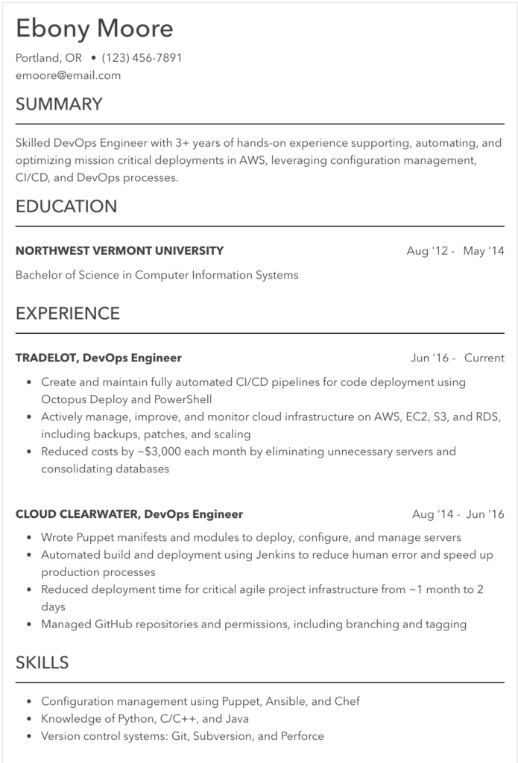

Slide 6
JOB SEARCH 101
Action Verbs and Quantification
Use strong action verbs to emphasize what you have done in an interesting and enthusiastic way. Use a cause and effect method to show your impact
Ex: Collaborated with… increasing cross location relations
Ex: Implemented… to boost production 15%
Ex: Trained… ensuring the success of future employees
Ex: Created… to streamline the inventory system
Ex: Ensured… lowering safety violations below 10%
Quantify anything you can in relation to your previous experience
Ex: Served over 40 customers a day
Ex: Trained 10 incoming employees
Ex: Effectively received and routed over 50 calls a day

Slide 7
JOB SEARCH 101
Key Heading | Content
Contact Details | Name, address, telephone, mobile and email address Your name should be on top line by itself and address etc. on line below Use a trusted email address you check regularly. Do not use a NSFW email, for example hotmomma69@gmail.com
Professional Experience | Typically organized in reverse chronological order (timeline) OR by area of expertise (functionally) Function e.g. Sales Assistant, HR Professional Employment history – include dates, name of organization, position/job role - include the past 10-12 years of your work life Your experience, responsibilities and accountabilities e.g. project management, people management etc. Your skills/areas of expertise – can also include soft skills e.g. your personal qualities Your significant achievements and the benefits these brought to an employer – these demonstrate your strengths
Education | Highest level attained listed first plus any other relevant qualifications and training courses Depending on the job, these normally come near the end of your resume Recent attendance on training courses shows that you are up-to-date and are still interested in learning
Optional Information | May include: memberships to professional/trade organizations, technical skills, languages, licenses, certificates and interests

Slide 8
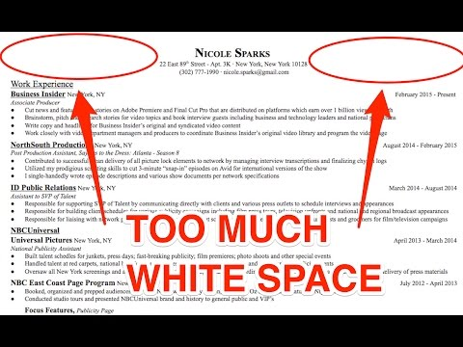
JOB SEARCH 101

Slide 9
JOB SEARCH 101
PROBLEM SOLVING – COMMON CONCERNS
Gaps in work history
If these are obvious, give a positive statement about what you were doing during this time. Don’t apologize!
You could position this as a ‘Career Break’ and include this in your employment history (including dates e.g. 2012 - 2014)
Little or no experience in the industry
Use a functional resume format to present your transferable skills
Provide examples of key achievements that link to the industry or job you are applying for
Work experience has been with a wide variety of employers (lots of jobs in a short time)
Choose a functional resume format
Emphasize your skills and achievements up front
You can combine jobs into related groups (e.g. hospitality, sales, customer service)
Lack of formal qualifications
Does your ‘on the job’ experience outweigh a formal qualification?
Think about any equivalent experience you have gained in a job – list any ‘on the job’ training that is relevant
List any relevant developmental courses, training, seminars or workshops you attended
You can combine jobs into related groups (e.g. hospitality, sales, customer service)

Slide 10
JOB SEARCH 101
PROBLEM SOLVING – COMMON CONCERNS
Jobs held many years ago
Talk about any recent achievements or experience
List employer names and job titles only unless the responsibilities link to the job you are applying for
Presenting work history & education from another country
Give foreign qualifications along with the local equivalent
Outline positions held that in terms that are familiar to the employer/country
Emphasize experience that is relevant to the job you are applying for
Military background
Choose a functional resume style that emphasizes your accomplishments and skills
State your experience in civilian or general business language
Emphasize any training you received in the military, relevant to the job e.g. leadership skills, communication skills etc.

Slide 11
JOB SEARCH 101
GETTING AN INTERVIEW
Avoid the “spray and pray” tactic. Work smarter not harder by strategically applying for the jobs you want and/or are qualified for.
Job Posting Websites (create accounts & save filtered searches):
Indeed.com
CareerBuilder.com
US.jobs
Monster.com
Idealist.com
LinkedIn.com (only if you have an active and professional online presence)

Slide 12
JOB SEARCH 101
GETTING AN INTERVIEW
When applying for a job:
Follow instructions
Be consistent - make sure the information in your application matches your resume
Be thorough - complete all fields and triple check for typos
Stay organized - if you customize your resume for each application, be sure to use the intended version
Follow up - set a reminder to communicate your continued interest and confirm the position’s status

Slide 13
JOB SEARCH 101
You’ve got an interview! Now what?

Slide 14
JOB SEARCH 101
A few days before the interview:
Learn as much as you can about the prospective employer.
Review your resume. Think about how your skills and accomplishments can be assets to the company.
Be prepared to answer these standard questions:
Can you tell me a little about yourself?
Why do you want to work here? What do you know about the company?
What are your strengths/weaknesses?
Practice answering interview questions out loud. You want your responses to sound confident but not rehearsed.
Prepare your own list of questions to ask the interviewer. Remember: this is your opportunity to learn more about the position and the company’s culture.

Slide 15
JOB SEARCH 101
The day before the interview:
Make plans for getting to the interview; know exactly where you’re going and to whom you will be speaking.
Allow extra time to get to your interview in case there are delays due to rush hour or weather.
Review the bus schedule, fill your car with gas; or re-confirm other transportation plans.
Decide what you will wear and check that it is clean, pressed, has no missing buttons, etc.
Confirm child care and any other plans that require you to depend on someone else. Have a back-up plan in case your primary one falls through.

Slide 16
JOB SEARCH 101
The night before the interview:
Check the weather forecast. Will you need an umbrella? Should you wear a coat?
Plan how you will wear your hair and makeup. You shouldn’t try anything new, and your appearance should be appropriate for a professional setting.
Your fingernails should be conservative in length and color, and your polish should not be chipped.
Do as much of your morning preparation as you can for both yourself and your family.
Do something to relax, such as taking a warm bath or exercising.

Slide 17
JOB SEARCH 101
Remember to bring:
Photo identification for building security or your application
Directions to the interview and the exact address, including floor and suite numbers
The name and phone number of the interviewer in case you’re running late
A few copies of your resume and cover letter. Don’t forget to prepare a list of professional references, too
A pad or paper and pen
Samples of your work if you’ve been asked to bring them or think you might have an opportunity to show them

Slide 18
JOB SEARCH 101
The day of the interview:
An interview starts as soon as you step inside the building. Be courteous to everyone you meet - you never know who has a say in the hiring decision.
Go light on the perfume. If you smoke, try not to do so right before the interview.
Give yourself plenty of time to get to the hiring manager’s office. Aim to arrive 10 minutes early. If you arrive earlier than that, take a walk or wait outside.
If you feel nervous, take a deep breath, counting to 10 as you do so. Then exhale slowly to the same count.
Turn off your cell phone. The interview is too important to be interrupted.

Slide 19
JOB SEARCH 101
Interview DOs:
DO be friendly. Give a firm handshake, make eye contact, speak up.
DO SMILE.
DO take out your pad of paper and pen so you can take notes.
DO tell yourself you deserve the job.
DO use the interview to describe your strengths and how they align with the requirements of the position.
DO be prepared to talk about your professional goals.
DO be enthusiastic, courteous and alert throughout the entire interview.
DO sit calmly. If you tend to gesture a lot when you talk, try clasping your hands in your lap.
DO ask for a business card so that you can send him or her a short and prompt thank-you note and e-mail.

Slide 20
JOB SEARCH 101
Interview DON’Ts:
DON’T bring a friend or child along.
DON’T be insincere. Fake flattery shows.
DON’T wear flashy or noisy jewelry (keep it simple and small) or a facial piercing.
DON’T speak negatively about former employers or colleagues. DON’T start with questions about your salary or time off.
DON’T be afraid to express your interest in the position.
DON’T slump, yawn or chew your nails or gum during the interview.
DON’T panic if you make a mistake, trip over your words or even knock something over.

Slide 21
JOB SEARCH 101
After the interview:
Send the interviewer a thank-you note within 48 hours of your interview. Use the opportunity to restate your qualifications and interest in the position.
Stay positive! Interviewing can be a lengthy process, especially if a company wants to conduct a second interview with additional staff members.

Slide 22
JOB SEARCH 101
Dress for Success Northwest Arkansas
Frisco Station Mall, 100 N Dixieland, Rogers, AR 72756
Phone: (479) 877-6910
Email: northwestarkansas@dressforsuccess.org
Career Center Website
https://dfsnwa.org/programs/career-services/
Hours of Operation:
Monday- Thursday 10:00am - 4:00pm
Follow, like, comment, share, retweet, repost us on social media to help spread awareness and support for our clients, events and mission!

